Slide 1

Visualization of statistics from VK by example of outer space communities.
Maliutin Alexey, M4119c
The High-Performance Computing Department
16th January, 2018

Slide 2
Main question:
How can we popularize information about the outer space in social network?
2/13

Slide 3
Main question:
How can we popularize information about the outer space in social network?
2/13

Slide 4
Main question:
How can we popularize information about the outer space in social network?
#notScienceWay
2/13

Slide 5
Concrete questions:
Who is the audience of groups about Space?
How this audience does react on specific events?
What is the best way of sale data on the market?
2/13

Slide 6
Concrete questions:
Who is the audience of groups about Space?
How this audience does react on specific events?
What is the best way of sale data on the market?
#DataVisualization
2/13

Slide 7
Table of content
INTRODUCTION
MAIN PART
Data
Solved tasks
Pros and cons
DEMO
CONCLUSION
3/13

Slide 8
Introduction
VK collect a vast amount of data about member of groups
VK group stat shows data just for one group
The majority of entities as a text
VK allows to download stats from groups with trivial stats.get command
Non-intuitive and unfitted for presentation purpose
4/13

Slide 9
Introduction
VK collect a vast amount of data about member of groups
VK group stat shows data just for one group
The majority of entities as a text
VK allows to download stats from groups with trivial stats.get command
Download and Munge Data
Select the types of visualization
Implement it
Present it!
4/13

Slide 10
DATA
Date | Item | Parameter 1 | Parameter 2 | Value
19.11.2017 | views |  |  | 574
19.11.2017 | visitors |  |  | 399
19.11.2017 | gender | Ж |  | 98
19.11.2017 | gender | М |  | 285
19.11.2017 | age | 1-18 |  | 51
19.11.2017 | age | 18-21 |  | 52
19.11.2017 | cities | Москва |  | 38
19.11.2017 | cities | Санкт-Петербург |  | 25
19.11.2017 | cities | Новосибирск |  | 9
19.11.2017 | cities | Краснодар |  | 8
19.11.2017 | cities | Минск |  | 6
19.11.2017 | cities | Красноярск |  | 5
19.11.2017 | cities | Самара |  | 5
19.11.2017 | cities | Екатеринбург |  | 5
5/13

Slide 11
DATA
Date | Item | Parameter 1 | Parameter 2 | Value
19.11.2017 | views |  |  | 574
19.11.2017 | visitors |  |  | 399
19.11.2017 | gender | Ж |  | 98
19.11.2017 | gender | М |  | 285
19.11.2017 | age | 1-18 |  | 51
19.11.2017 | age | 18-21 |  | 52
19.11.2017 | cities | Москва |  | 38
19.11.2017 | cities | Санкт-Петербург |  | 25
19.11.2017 | cities | Новосибирск |  | 9
19.11.2017 | cities | Краснодар |  | 8
19.11.2017 | cities | Минск |  | 6
19.11.2017 | cities | Красноярск |  | 5
19.11.2017 | cities | Самара |  | 5
19.11.2017 | cities | Екатеринбург |  | 5
Thx, Anastasia!
5/13

Slide 12
DATA
Date | Item | Parameter 1 | Parameter 2 | Value
19.11.2017 | views |  |  | 574
19.11.2017 | visitors |  |  | 399
19.11.2017 | gender | Ж |  | 98
19.11.2017 | gender | М |  | 285
19.11.2017 | age | 1-18 |  | 51
19.11.2017 | age | 18-21 |  | 52
19.11.2017 | cities | Москва |  | 38
19.11.2017 | cities | Санкт-Петербург |  | 25
19.11.2017 | cities | Новосибирск |  | 9
19.11.2017 | cities | Краснодар |  | 8
19.11.2017 | cities | Минск |  | 6
19.11.2017 | cities | Красноярск |  | 5
19.11.2017 | cities | Самара |  | 5
19.11.2017 | cities | Екатеринбург |  | 5
4 groups and more than 30k rows annually per each
Row-by-row isn’t a hierarchical structure
No regions, just a cities
Require modification
JSON
5/13

Slide 13
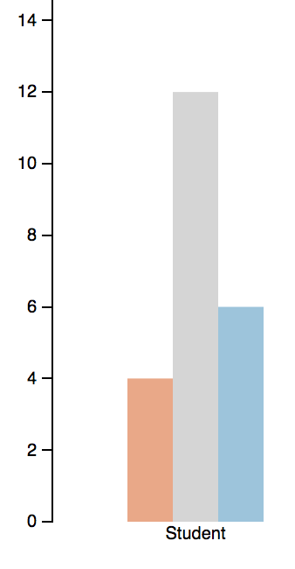
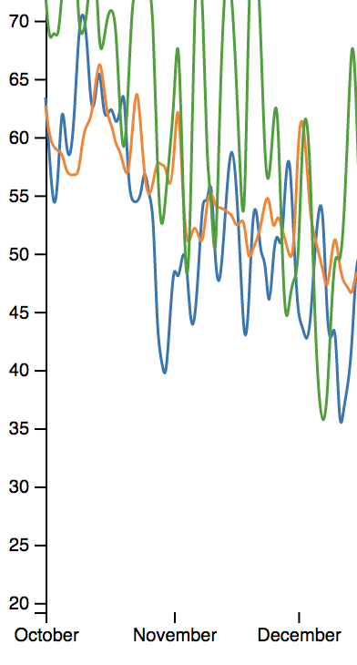

Solved task:
Information about distinct groups on one graph
Great for specific data
Easier implementation
A mess with wide range of values
Non-fitted for time series
VS.
Great visualization for long time period +
Lightness despite of the values +
Non-trivial interactivity –
Looks awful without of context –
6/13

Slide 14
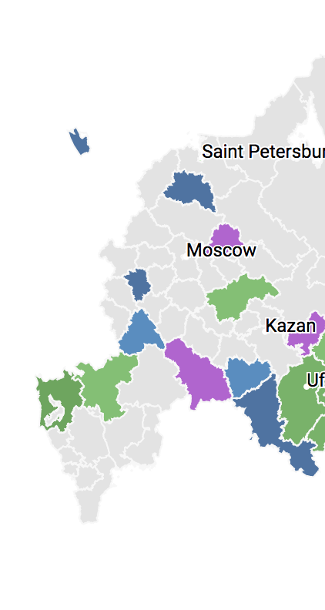
Solved task:
GEO and regional distribution
City | Value
Moscow | 574
St. Petersburg | 399
Perm | 98
Kazan | 285
Sochi | 51
Ufa | 52
Vladivostok | 38
Omsk | 25
Tomsk | 9
Krasnodar | 8
Novosibirsk | 6
Fitted for text data
High accuracy and focusing on values
Require a lot of space on the page
A bit boring
VS.
The most natural way for GEO visualization +
High interactivity +
Required data adaptation –
High-load on the client side –
7/13

Slide 15
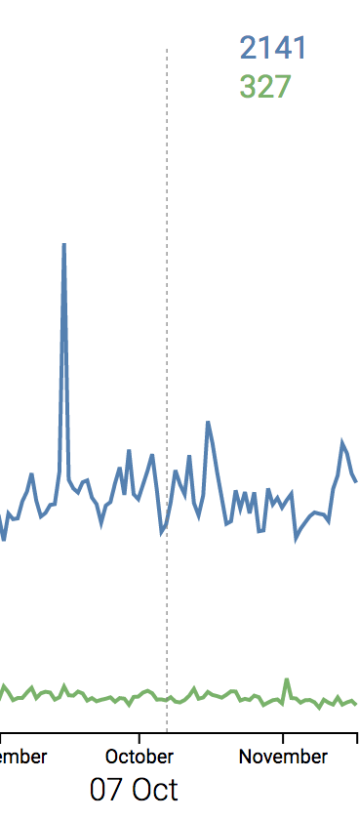
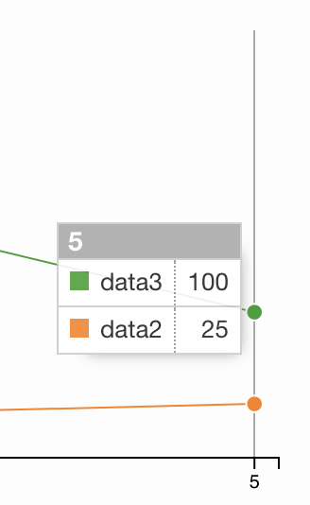
Solved task:
Dynamics over days
Focusing on values
Can disturb over day-by-day iteration
Overflow graph
VS.
No interferences with graph itself +
Focusing on values +
Unclear without context –
8/13

Slide 16
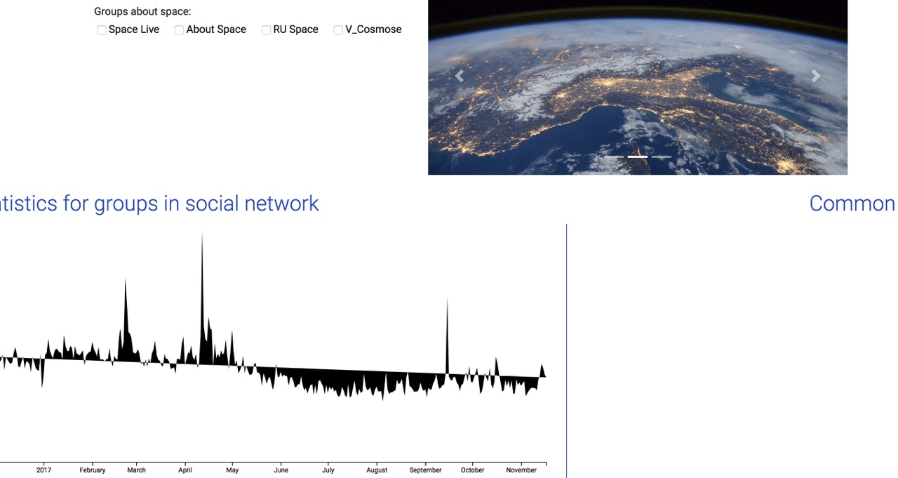
Implementation
9/13

Slide 17
Implementation
#joke
9/13

Slide 18

LIVE DEMO
https://alexworldd.github.io/SpaceVK/
10/13

Slide 19
CONCLUSION
The given result could be easily adapted for any kind of group
Implemented techniques and methods are universal
High-performance and smooth animation has been achieved by data modification
The prospect and evolution ways for further work
11/13

Slide 20
Questions?
12/13

Slide 21

Thank you for attention!
malutin.alex@gmail.com
www.ifmo.ru

